Slide 1

Building Pokemon Stay – DSI Project 1
Haden Hang Liu

Slide 2
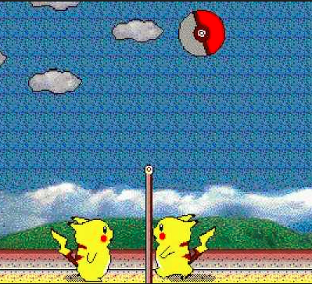
Purpose for development
Assist to new game development
New game which involves visiting certain websites to catch the Pokemon
Create game elements with Data structure, control flow & functions of Python

Slide 3
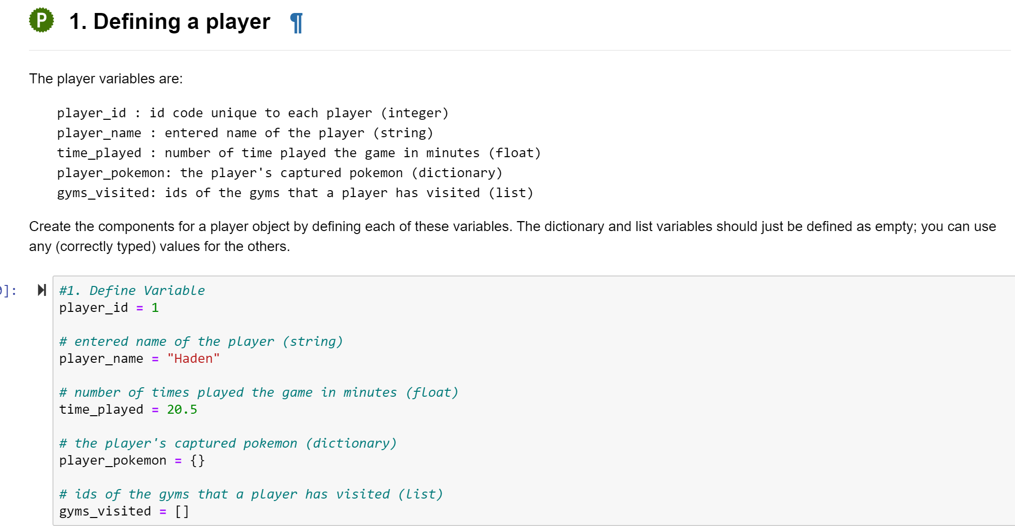
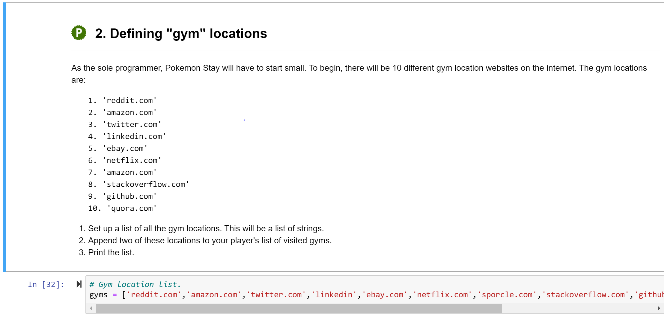
Creating Variables and data structure
Generate basic information of players and gyms with Python Data Structure
Modify data structures with information appending & inserting

Slide 4
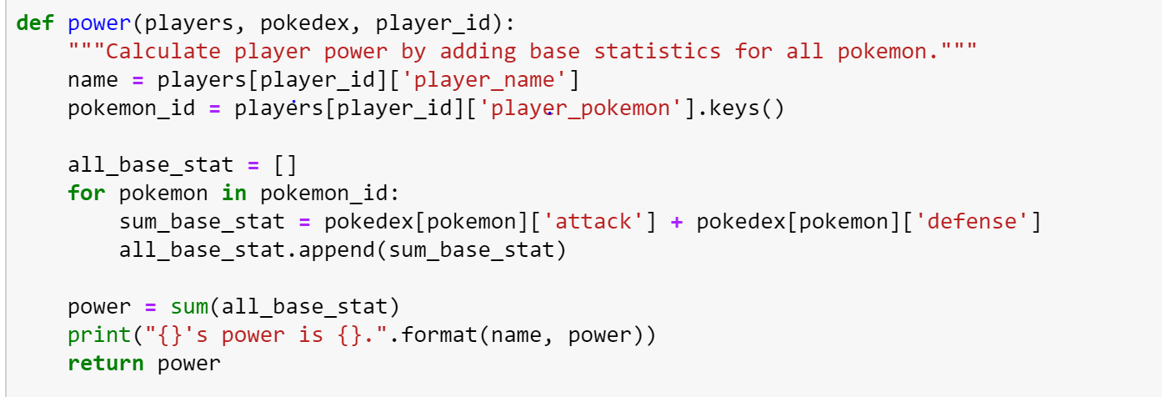
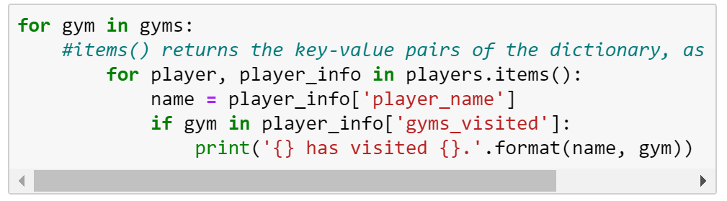
Application of Control Flows
Access players activities with general loops
Convert between general loop and list comprehensions
Do data cleaning and calculations within functions

Slide 5
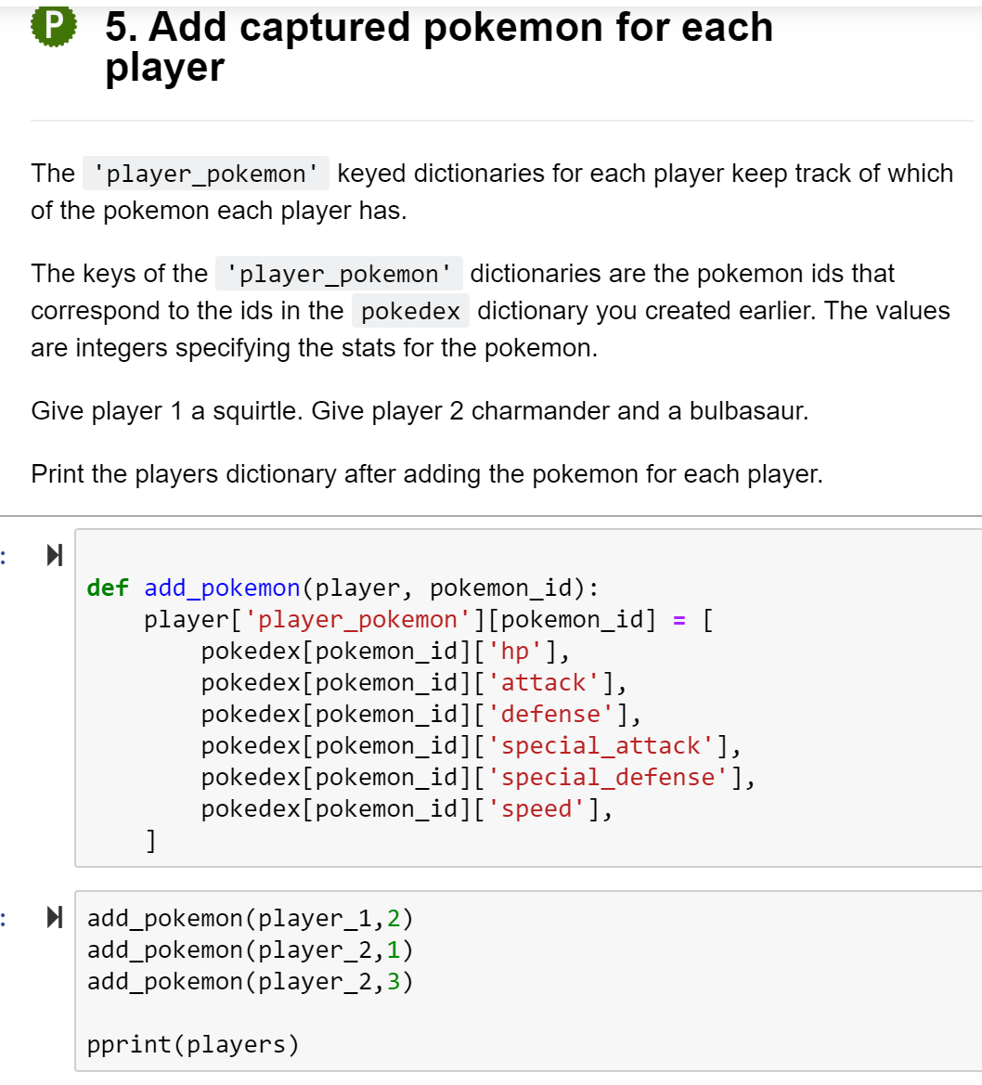
Create Functions
Create functions to conduct various data processing tasks

Slide 6
Challenges & difficulties
Convert from general loops to list comprehension
Analysis requirements of function

